Slide 1

CS425[FZ]
Audio and Speech Processing
Assignment1
MMWD1 22124187
Zhang Linyihan

Slide 2
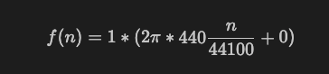

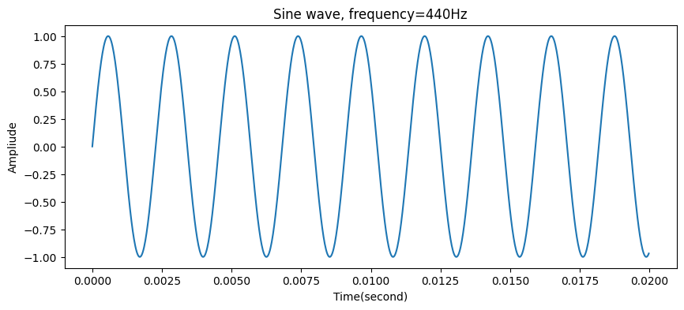
Waveforms
Q1
I designed a sine wave, and its equation and audio are as follows:

Slide 3
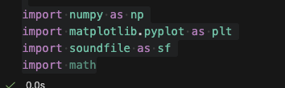
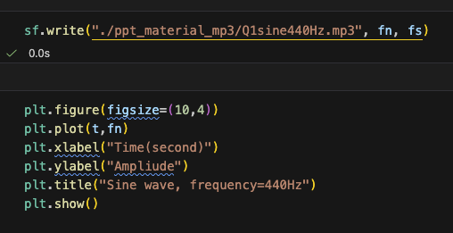
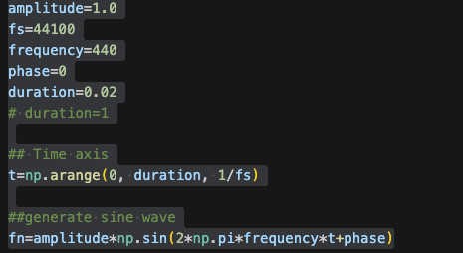
Waveforms
Q1
The codes of Q1 is as follows:

Slide 4
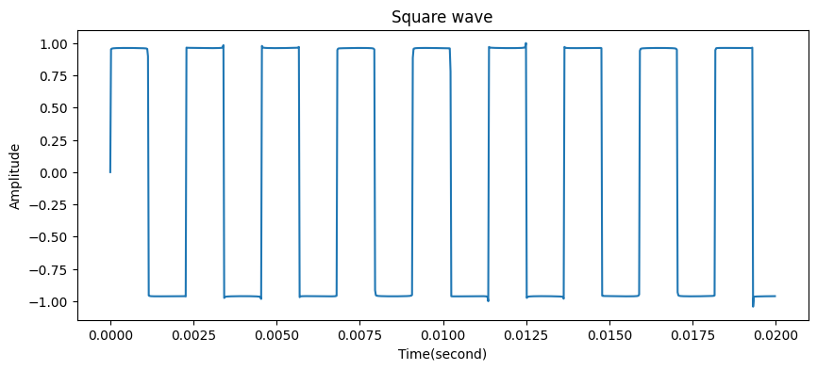
Waveforms
Q2
I designed a square wave, and its audio are as follows:

Slide 5
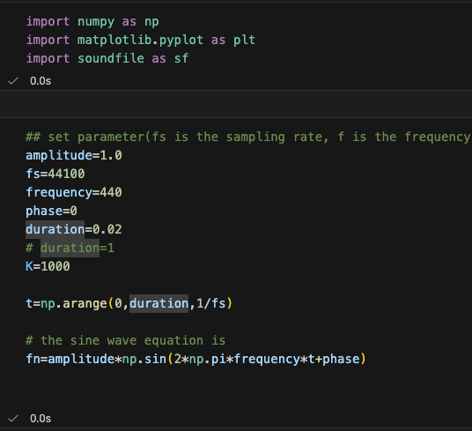
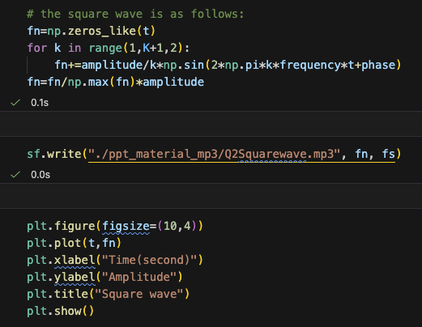
Waveforms
Q2
The codes of Q2 square wave is as follows:

Slide 6
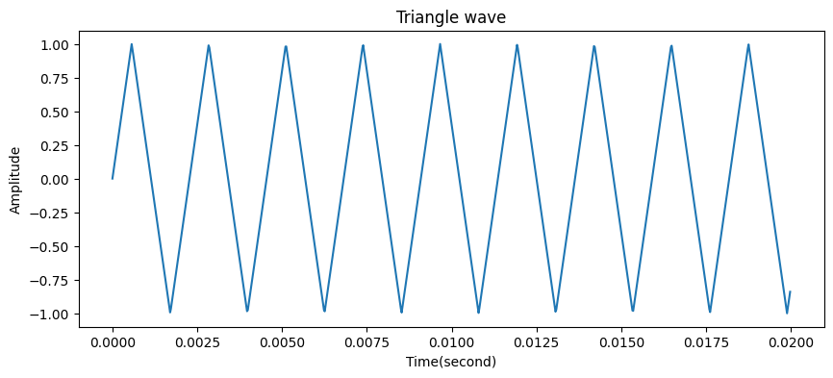
Waveforms
Q2
I designed a triangle wave, and its audio are as follows:

Slide 7
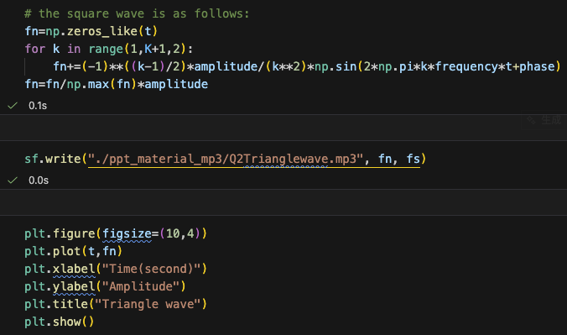
Waveforms
Q2
The codes of Q2 triangle wave is as follows:

Slide 8
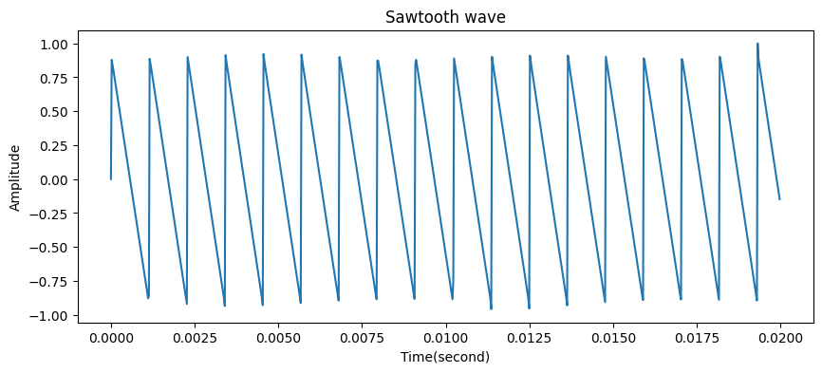
Waveforms
Q2
I designed a sawtooth wave, and its audio are as follows:

Slide 9
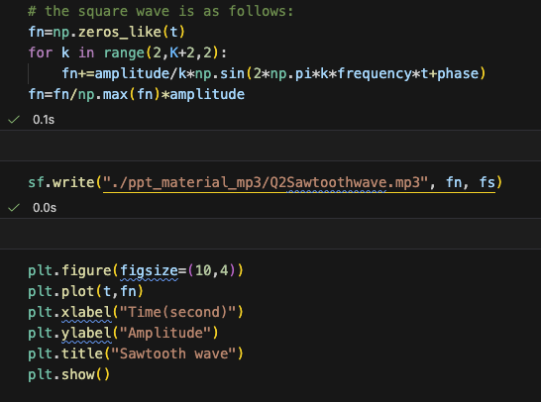
Waveforms
Q2
The codes of Q2 sawtooth wave is as follows:

Slide 10
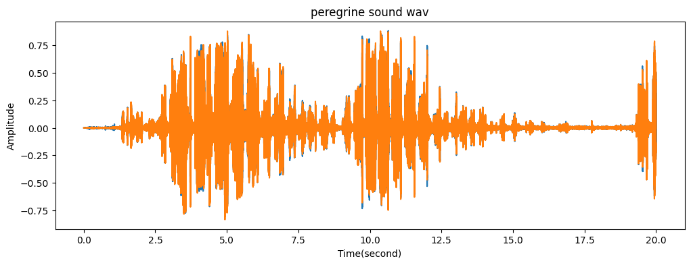
Waveforms
Q3
I showed a peregrine.wav[1] wave, and its audio are as follows:
[1] audio link：https://sound-effects.bbcrewind.co.uk/search?q=NHU05104233

Slide 11
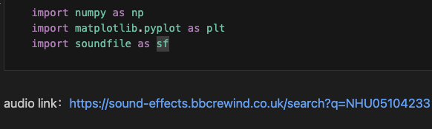
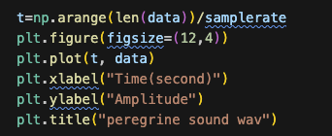
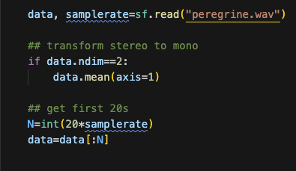
Waveforms
Q3
The codes of showing peregrine.wav wave is as follows:

Slide 12
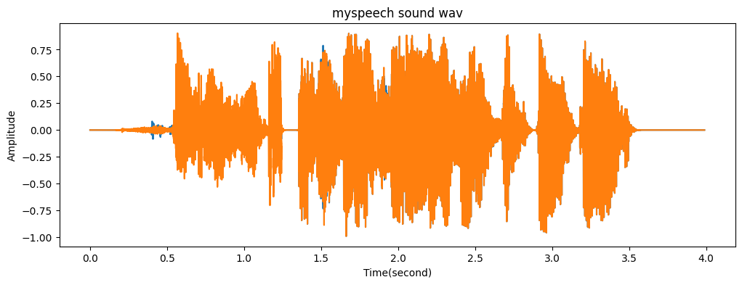
Waveforms
Q4
I recorded a myspeech.wav audio, and its wave and audio are as follows:
Content: I want to buy a shoes for my football game.

Slide 13
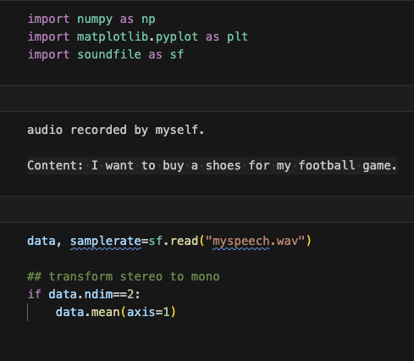
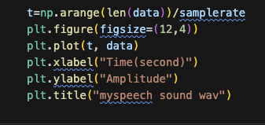
Waveforms
Q4
The codes of showing myspeech.wav wave is as follows:

Slide 14
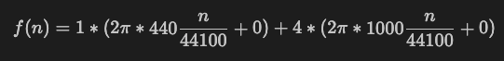
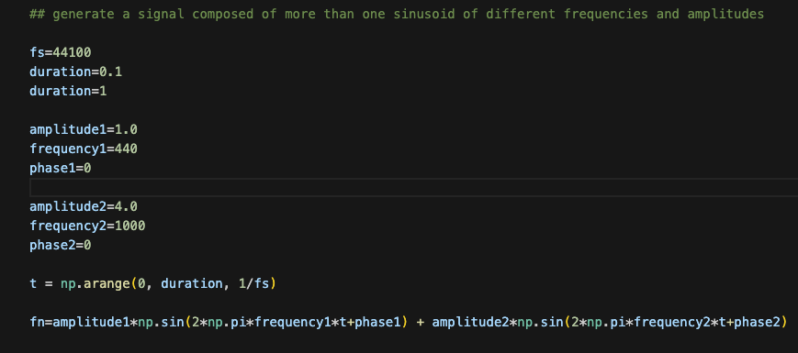
Fourier transform
Q5
I designed a multi-sine wave, and its equation, audio and codes are as follows:

Slide 15
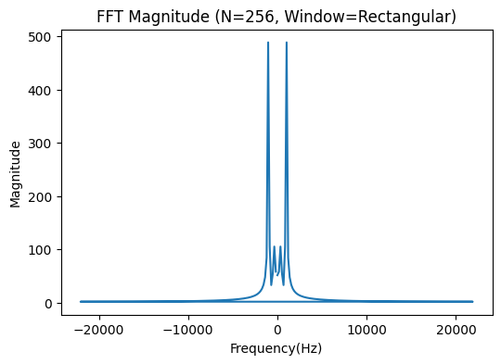
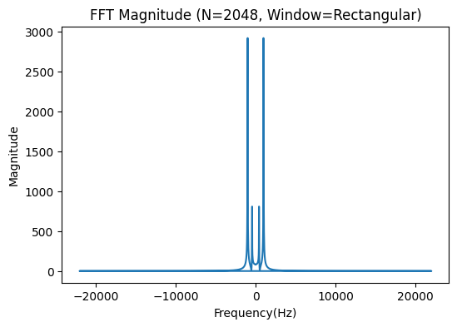
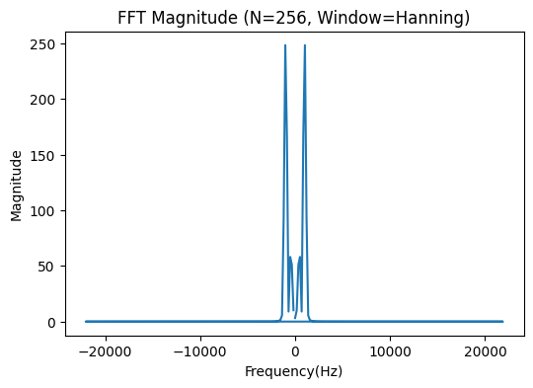
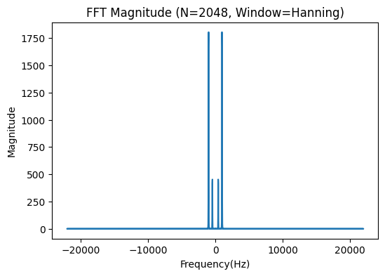
Fourier transform
Q5
Rectangular vs Hanning window
The rectangular window suddenly truncates the signal in the time domain which introduces the discontinuities at boundaries and resulting in spectral leakage.
Tha Hann window smoothly reduce the signal to 0 at both ends, producing a clear spectrum.
window size: 256 vs 2048
In N=256, the frequency components appear broader and less distinct.
In N=2048, the frequency components appear shaply and time components is shorter than N=256.

Slide 16
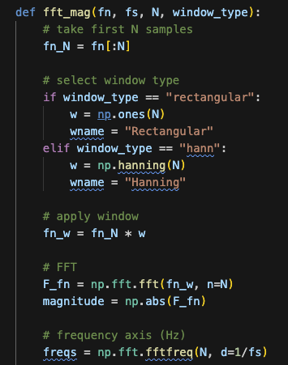
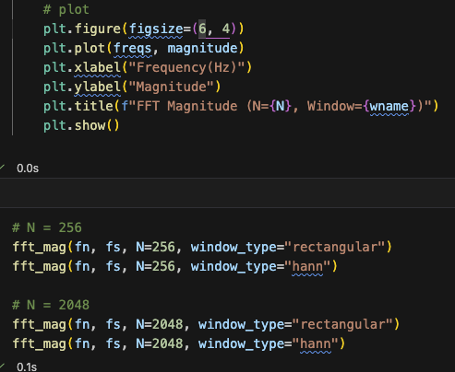
Fourier transform
Q5
The codes of Q5 is as follows:

Slide 17
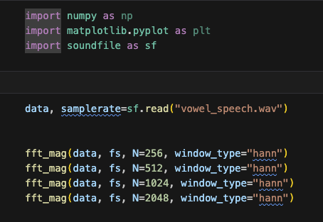
Fourier transform
Q6
I recorded a vowel_speech.wav audio, and codes of Q6 are as follows:
Content: aaaaaaaa~
Vowels show more than two formants because the vocal tract acts as a resonant tube with multiple resonance frequencies, each producing a formant in the spectrum.

Slide 18
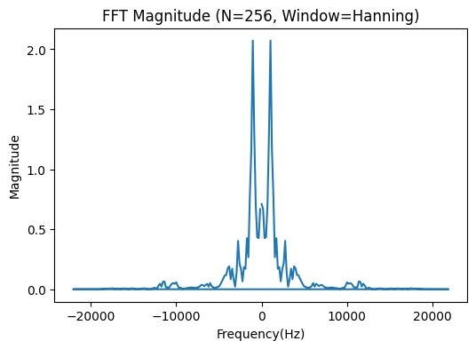
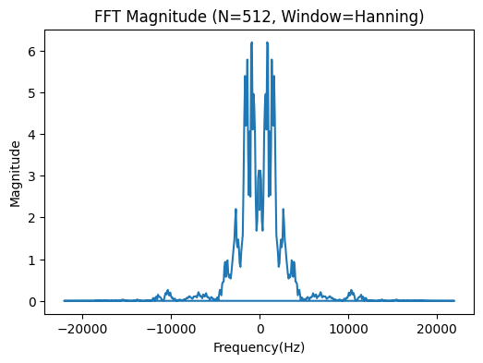
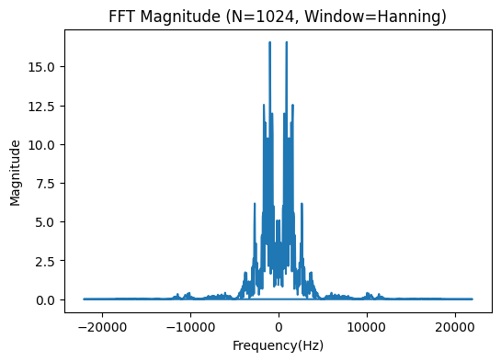

Fourier transform
Q6
The FFT figures of showing vowel_speech.wav in different window sizes N are as follows:

Slide 19
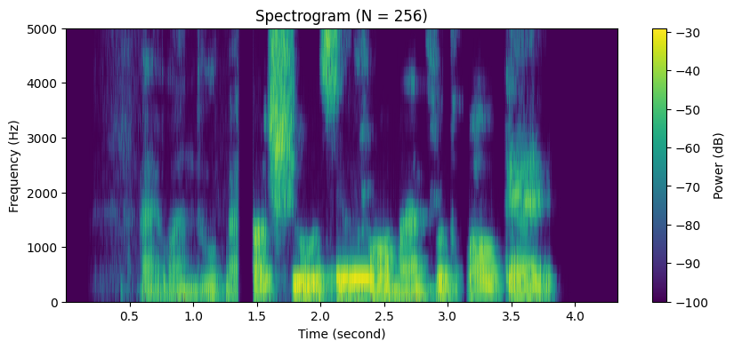
Spectrogram
Q7
I recorded a myspeech.wav audio, and its spectrogram and audio are as follows:
Content: I want to buy a shoes for my football game.

Slide 20
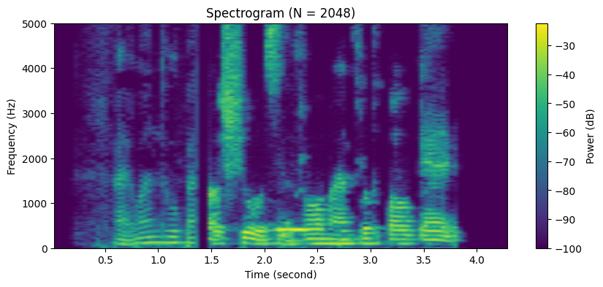
Spectrogram
Q7
This spectrogram shows the time–frequency representation of the speech signal. And color indicates the spectral power.

Slide 21
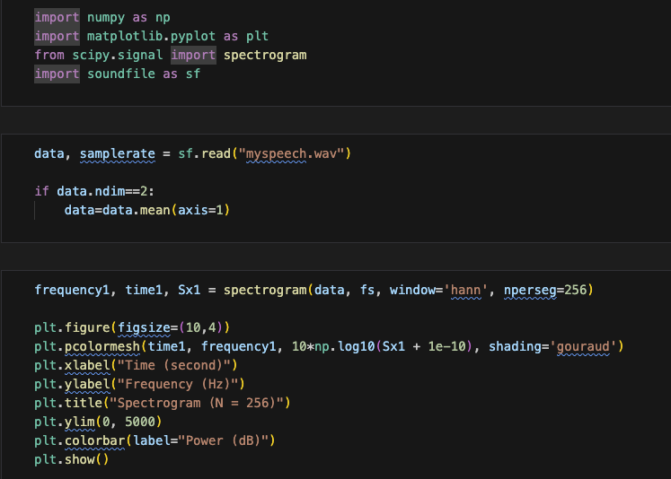
Spectrogram
Q7
The codes of showing myspeech.wav spectrogram is as follows:

Slide 22
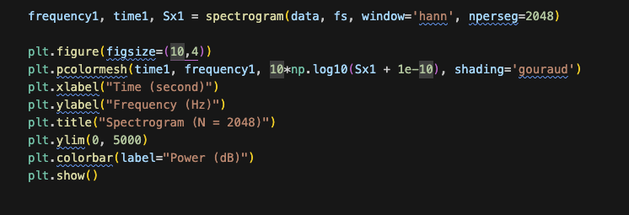
Spectrogram
Q7
The codes of showing myspeech.wav spectrogram is as follows:

Slide 23
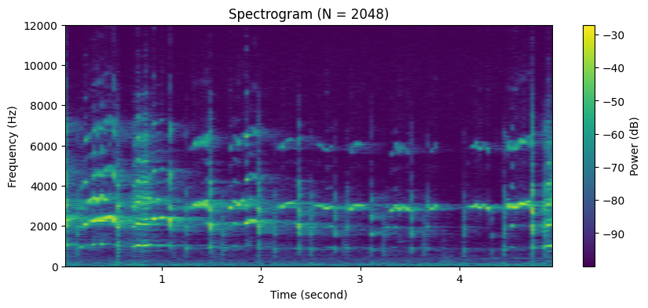
Spectrogram
Q8
I found Q8peregrine5_10s.mp3[1] audio, and its spectrogram and audio are as follows:
[1] audio link：https://sound-effects.bbcrewind.co.uk/search?q=NHU05104233

Slide 24
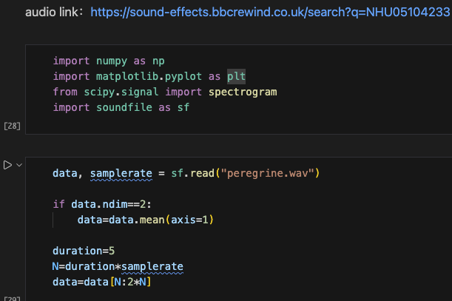
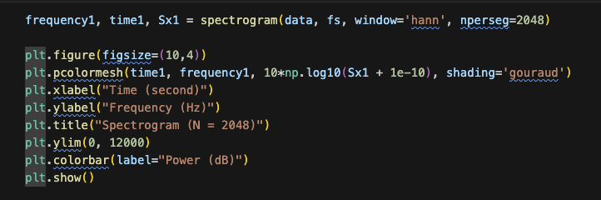
Spectrogram
Q8
The codes of showing Q8peregrine5_10s.mp3[1] spectrogram is as follows:

Slide 25
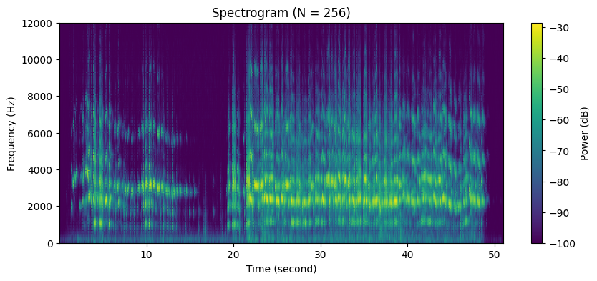
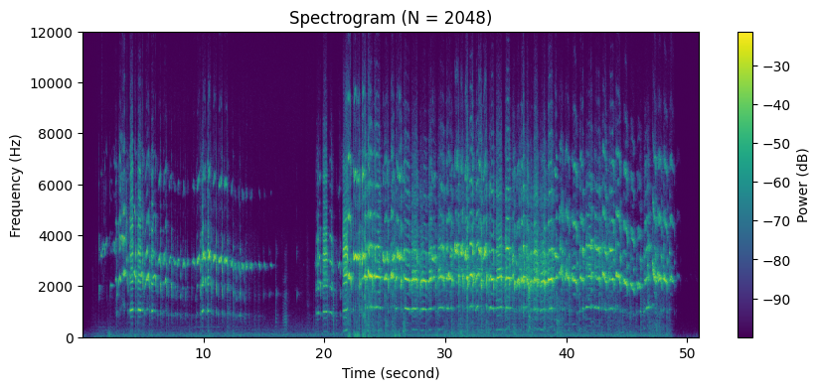
Spectrogram
Q9
I found Drum_loop.wav[2] audio, and its spectrogram in N=256 and 2048 are as follows:
According to two figures, when N=256 then vertical lines are clearly segmented than the N=2048.
[2] audio link: https://samples.landr.com/collections/free-drum-loops-breaks?genres=electronic

Slide 26
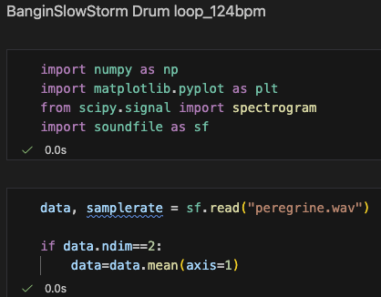
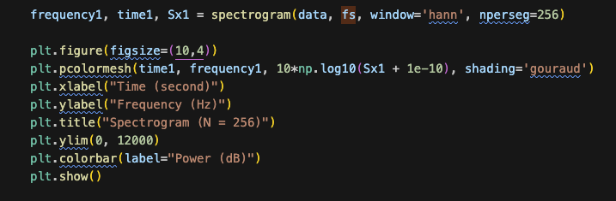
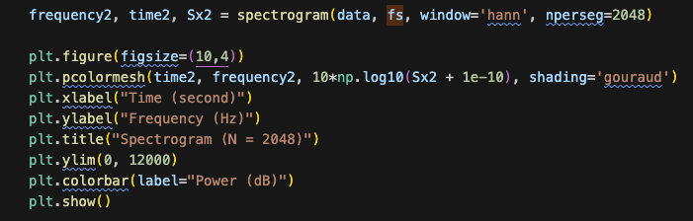
Spectrogram
Q9
The codes of showing Q9 is as follows:

Slide 27
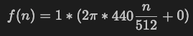
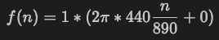
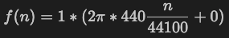
Sampling and Aliasing
Q10
I designed three sine wave with different sample rates, and its audio and codes are as follows:
When fs=512, aliasing occurs and I can hear dull and low frequency tone.
When fs=890, I can hear unstable and grainy tone at the pitch.
When fs=44100, I can hear clear and smooth tone at the pitch.

Slide 28
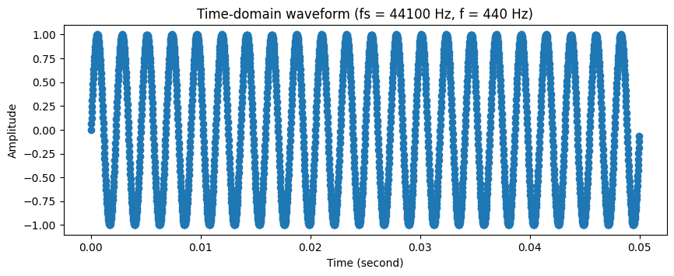
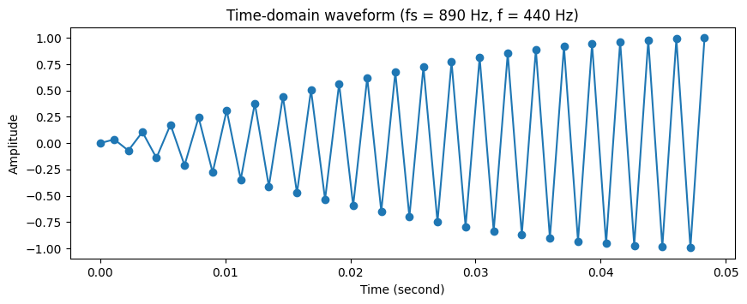
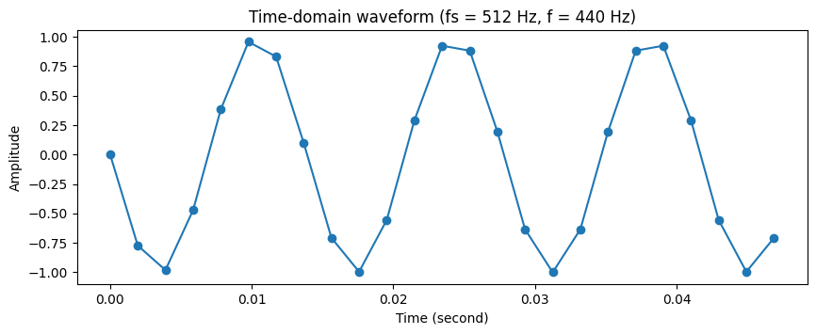
Sampling and Aliasing
Q10
Time Domain Analysis
fs = 44100 Hz: Accurate time-domain representation with no aliasing.
fs = 890 Hz: No aliasing, but severe distortion due to sparse sampling near the Nyquist rate.
fs = 512 Hz: Aliasing occurs。 The high-frequency sinusoid appears as a low-frequency waveform in the time domain.

Slide 29
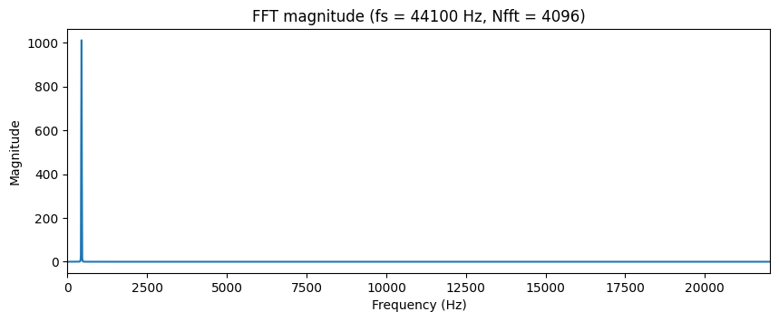


Sampling and Aliasing
Q10
FFT Magnitude Analysis
fs = 44100 Hz: When the signal is sampled well above the Nyquist rate, the original frequency is accurately preserved.
fs = 890 Hz: Sampling close to the Nyquist rate maintains the correct frequency but degrades spectral quality
fs = 512 Hz: Sampling below the Nyquist rate causes aliasing, resulting in a low-frequency component.

Slide 30




Spectrogram
Q10
The codes of showing Q10 is as follows:

